Slide 1
RFID, Fingerprint & Keypad Based Access Control & Alert System

Slide 2
RFID, Fingerprint & Keypad Based Access Control & Alert System
Submitted To: Engr. SUMAYYA
Submitted By: Abdul Hadi
Jamshid Ali

Slide 3
introduction
RFID, Radio Frequency Identification is a fundamental and inexpensive technology that enables wireless data transmission
This project is design to authenticate the user before entering a secure space
It also keeps the record of check-in and check-out of the user
The main objective of this paper is to design and implement a digital security system which can deploy in secured zone where only authentic person can be entered.

Slide 4
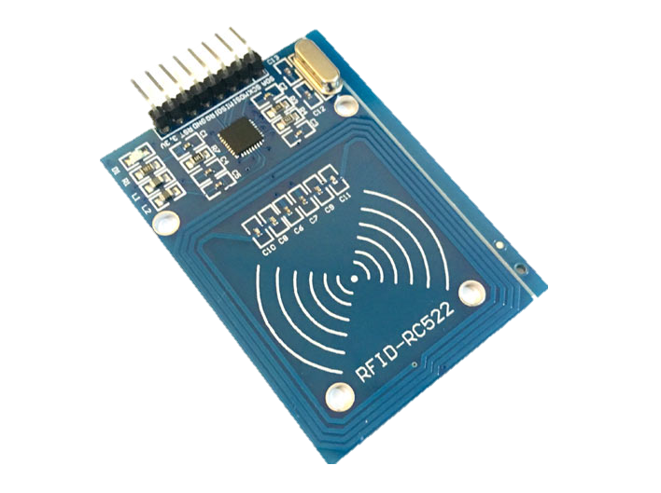
About Hardware
Radio Frequency Identification (RFID)
It basically uses the radio waves to read the information on the tag
RFID system include three basic elements:
RFID tag (transponder), reader (transceiver)

Slide 5
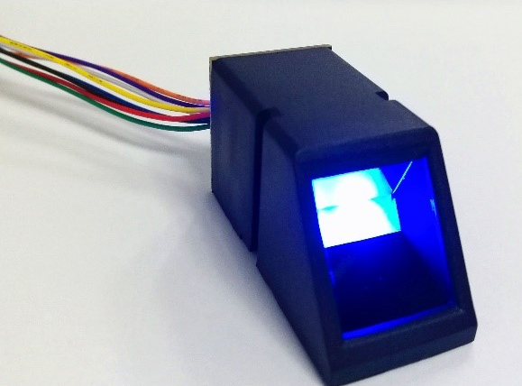
About Hardware
Fingerprint module
Biometric identification from a print made by an impression of the ridges in the skin of a finger
Reads users fingerprint and saves that to a db.
It is connected to Arduino to make it able to
read data.

Slide 6
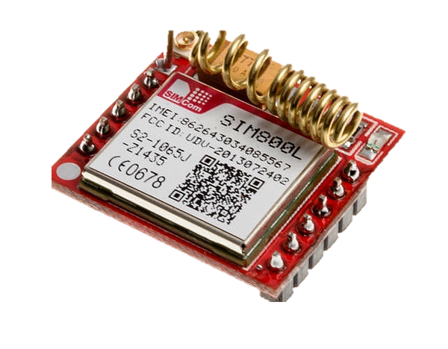
About Hardware
Gsm module
A GSM module is a circuit that will be used to establish communication between mobile device o and a GSM system
This module supports software power on
and reset.

Slide 7

How does it work?
The user will have to first scan the right tag and then he will have to enter the correct password
On scanning the wrong tag or on entering the wrong password or wrong fingerprint, the system will deny access

Slide 8

Algorithm
Start
Add these Libraries
EEPROM
MFRC22
LiquidCrystal_I2C
Keypad
Servo
SPI
Wire
Void Setup Function
Initialize Arduino pins for LEDs, Servo, Buzzer & tactile switch
Initialize bolean variables match, programMode, replaceMaster & successRead
Initialize arrays as storeCard, readCard,masterCard, storepPass, password & masterPass

Slide 9
Algorithm
Void Loop Function
Conditional statements
Master Tag
Enter Pass
If master tag scanned, then Exit
If known tag scanned, then Remove from EEPROM
If unknown tag scanned, then Enter New Pass & ADD to EEPROM
Other Tag
If known tag scanned, then Enter Pass & Grant Access
If unknown tag scanned, then Deny Access
Wipe Button
Wipe Data
Go To Void Loop Function

Slide 10
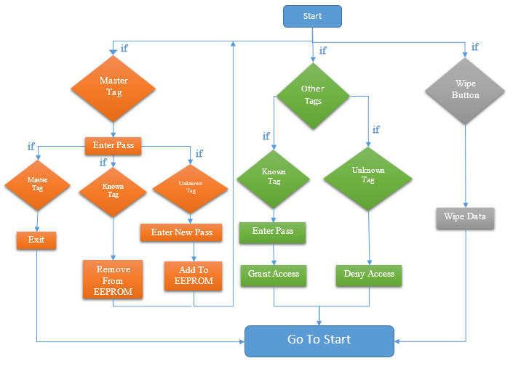
Flowchart

Slide 11
Progress

Slide 12
conclusion
The solution we are providing security system in order to avoid access of intruders.
We utilize RFID technology to provide solution for secure access of a space while keeping record of the user.

Slide 13



Any question

Slide 14


